Slide 1

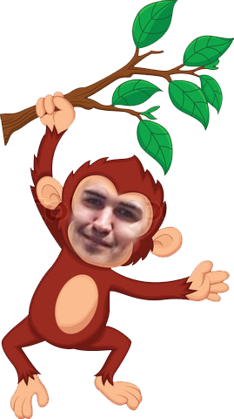
TEAM “ELLIOTT”

Slide 2
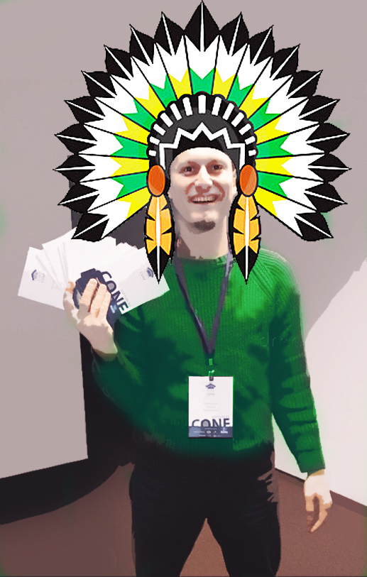
Team members:
Yulia Tenincheva (Yulia)
Vasil Kaludov (Vasilsk)

Slide 3

Our goals:
To Learn new things
To Work In Team
http://with.meandmy.softuni-friends.org

Slide 4

GUMBY
CSS Framework
+
SASS
+
Responsive
+
JS & CSS3 Animations

Slide 5
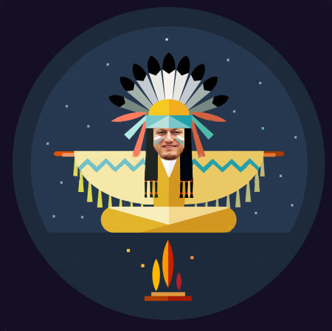
Validate
HTML5 & CSS3

Slide 6
GitHub
https://github.com/Elliott-SoftUni/Teamwork-Project/

Slide 7
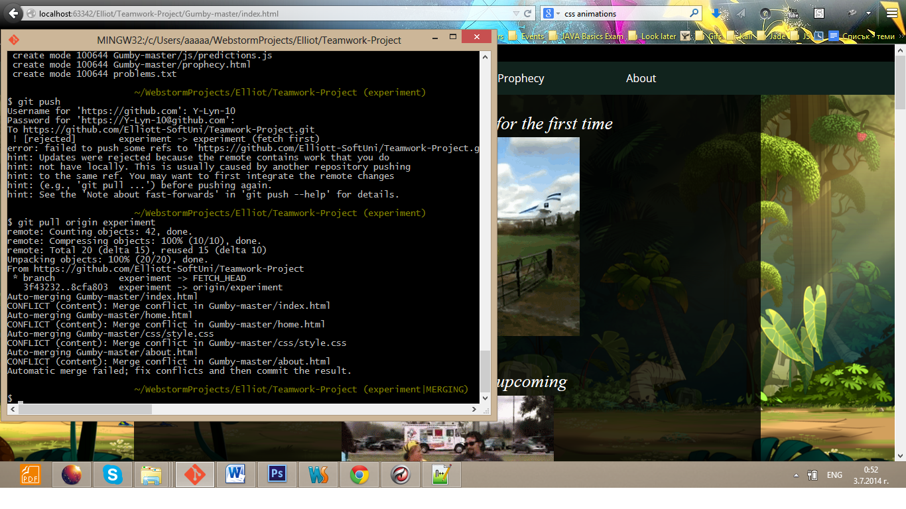
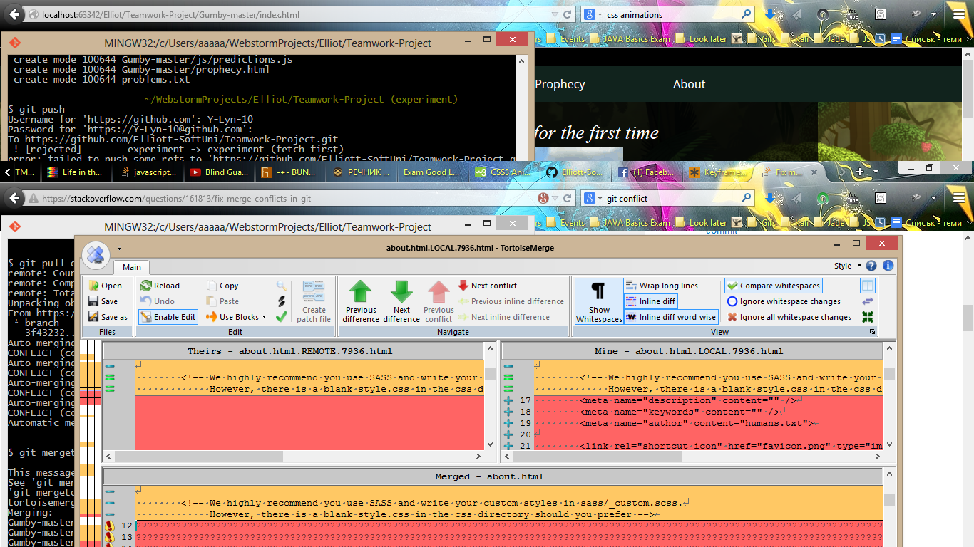
WOW
TEAM “ELLIOTT”

Slide 8
You can contribute too!

Slide 9
What we expect our reaction to be after the team project defense

Slide 10
Thank you!

